Slide 1
Ocean Acidification

Slide 2
Let’s hear the conversation of ben 10 about Ocean Acidification…

Slide 3
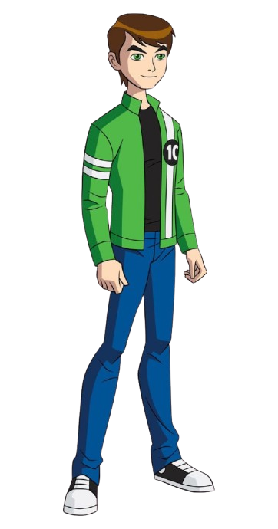
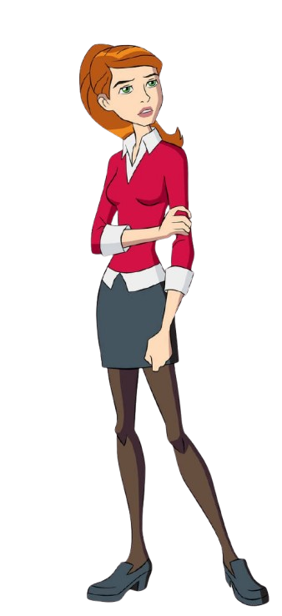
What is ocean acidification?
It’s when the ocean absorbs too much CO2, causing the water to become more acidic.

Slide 4
How does that affect marine life?
It harms creatures like coral reefs and shellfish, disrupting entire ecosystems.

Slide 5
Wow, that sounds serious! Can we tackle this issue?
Yes! Reducing carbon emissions and protecting marine habitats are key steps in addressing ocean acidification.

Slide 6
It’s important to protect our oceans for the health of the planet!

Slide 7
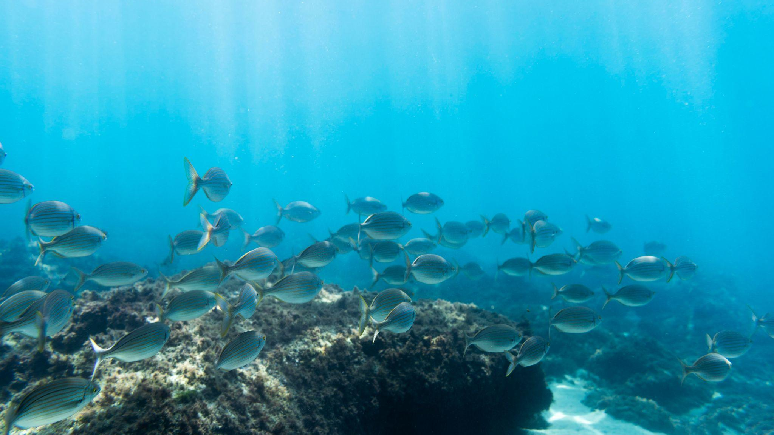
Tackling ocean acidification is crucial for the health of our marine life and ecosystems. By standing together to protect our oceans, we safeguard the biodiversity that sustains us and ensure that future generations can experience the beauty and bounty of our blue planet. Let us be the guardians of our oceans and champions for a resilient marine future….

